Slide 1
Augmented Reality Application for the benefit of the Garfield Park Conservatory Alliance
Jose Cuellar-Aguirre, Marcos Echevarria, Christian Garcia, Nick Tryba

Slide 2
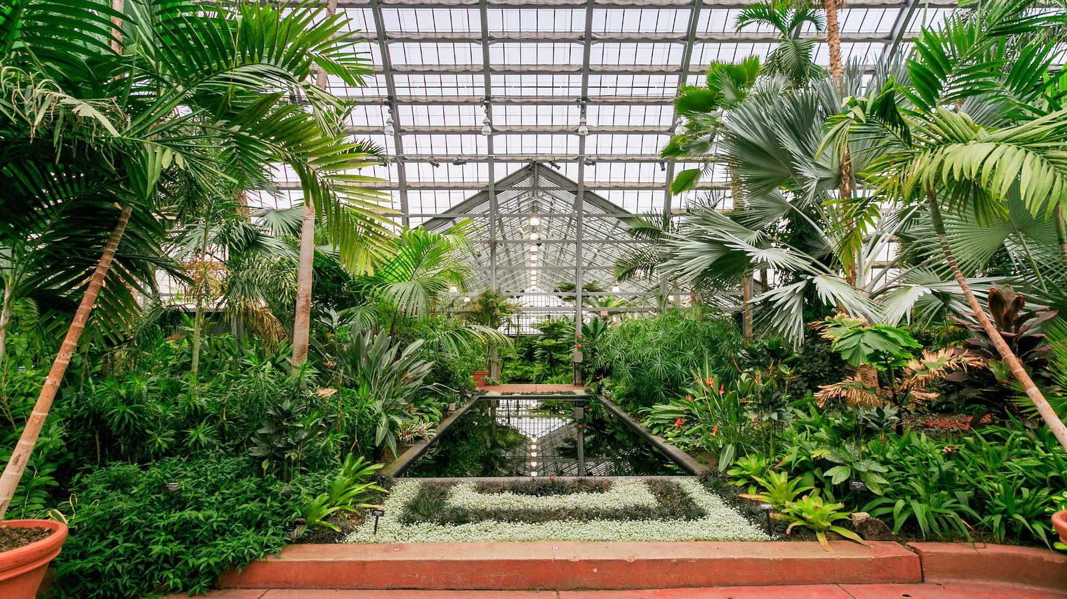
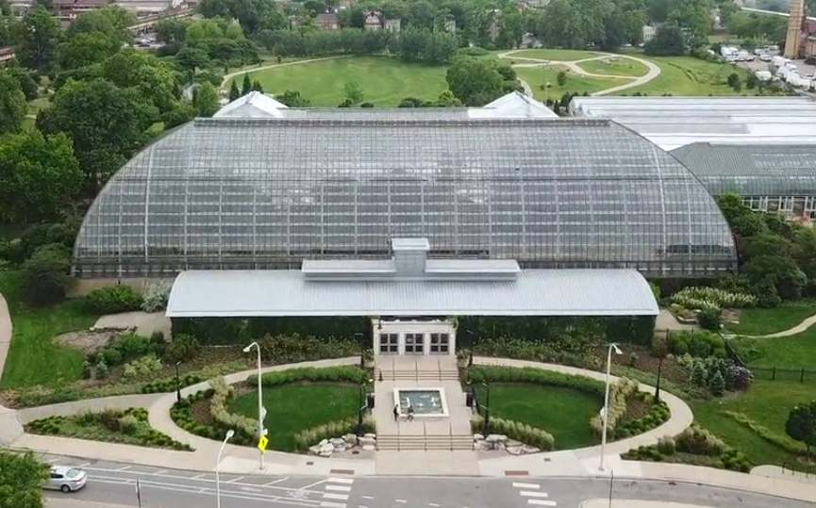
Garfield Park Conservatory
One of the largest conservatories in the nation.
Free admission (Optional Donation)
Garfield Park Conservatory Alliance provides the educational programming and fundraising.
Notes:
Marcos

Slide 3
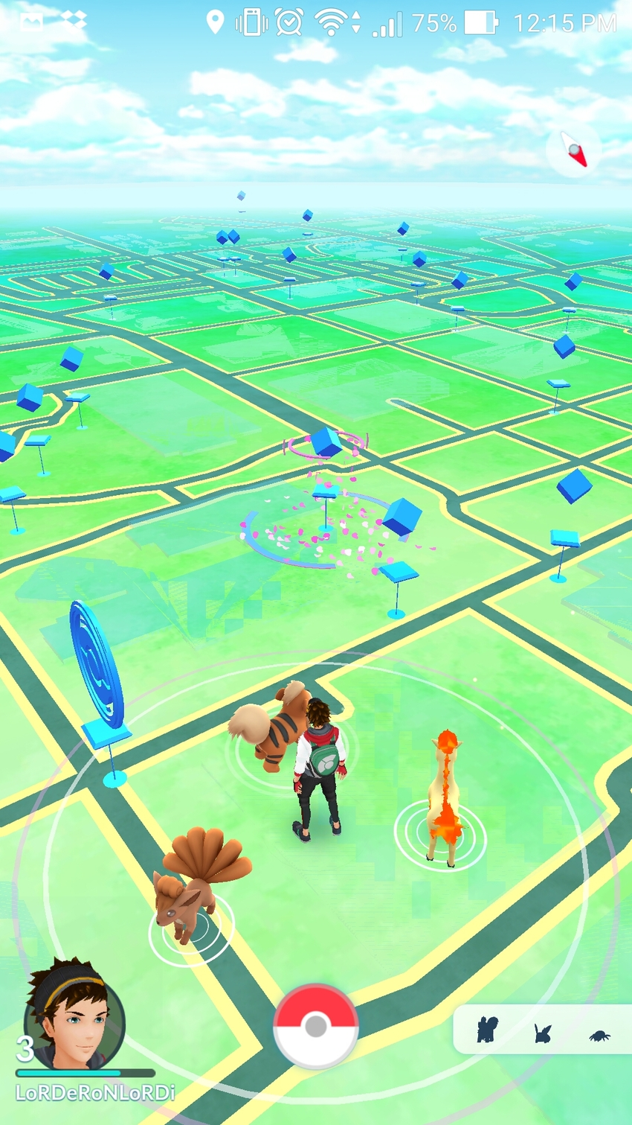
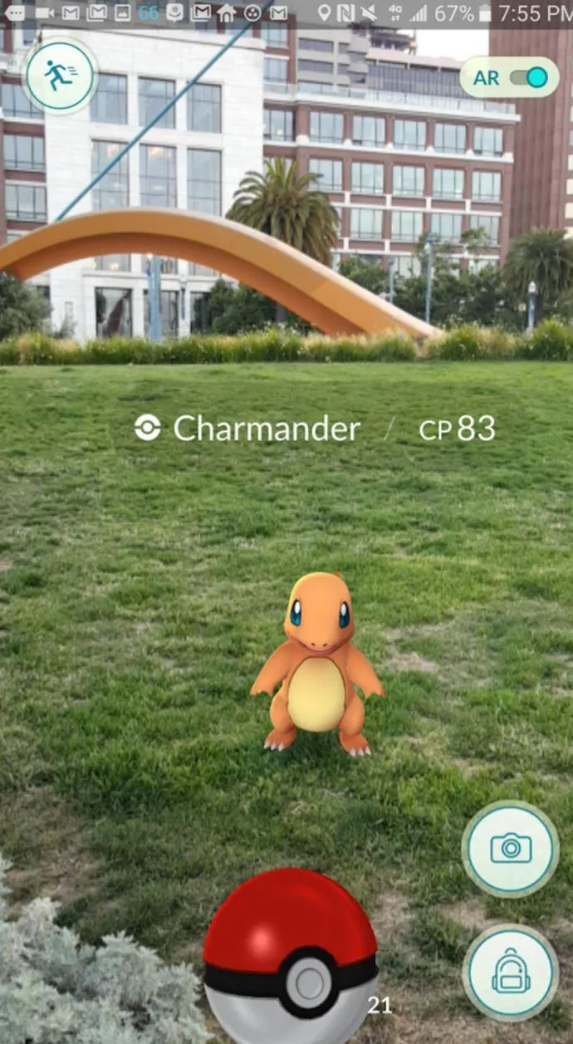
Project Overview
Augmented Reality Mobile Game
Walk around the conservatory and collect a variety of species.
Collect species by playing mini games and answering trivia.
Learn about each species collecting them and reading their descriptions
Notes:
Marcos

Slide 4
Purpose and Goals of the Project
Purpose: Promote interest in the Garfield Park Conservatory by offering a fun game to play alongside your tour of the conservatory.
Goals:
Increase number of visitors
Increase donations for the conservatory
Offer an alternative way of learning about new species
Encourage repeat visits
Notes:
Marcos

Slide 5
Scope of the Work
The current situation
Garfield Park Conservatory Alliance goes about achieving their goal by providing educational programming, events, and resources to GPC visitors.
The application will serve as another way to further achieve their goal, providing a means to extend the education to every tourist coming to GPC in a fun, interactive manner for free, and at any time in the GPC. It will also help fund future events through donations.

Slide 6
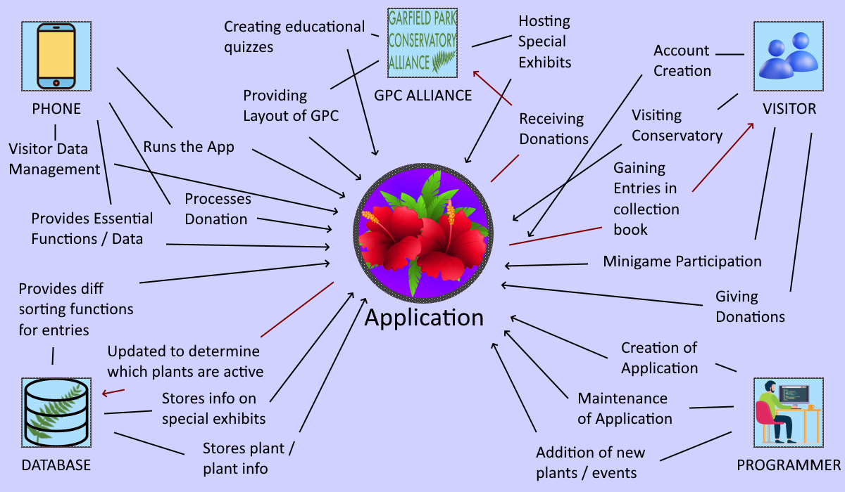
Scope of the Work (Continued)

Slide 7
Scope of the Product
Actions available to the User:
“Login” - Player creates or enters their profile credentials.
“Overworld” - Player movement is tracked via their location in the real world using location data from their mobile devices, this projects them onto the overworld that is navigated by their real life movement.
“Mini Games” - Players that choose to interact with those events, enter various mini games centered around learning about what they encounter.
“Collection” - Players will collect different things pertaining to the conservatory after completing mini games. This collection can be opened and data will be displayed to the user.
“Exit”- Allows the user to exit the game

Slide 8
Scope of the Product (continued)
Conservatory Information Specialist
Scenario Diagram
User initiates Exit
Profile Database Dev
Collection
User enters/leaves Collection
Rewards added to collection
USER
Event
Login
Overworld
Mini Games
User initiates Exit
Exit
Mini Game complete
User initiates Exit
Software
Dev

Slide 9
Stakeholders
The Client:
Garfield Park Conservatory would be able to attract more people to visit their location by extending their ability to educate visitors with a more interactive experience, that also incentivizes repeat visits. App purchases can also be implemented in the future to incentivize donations.
Yellowstone National Park can also use this app to create their own interactive experience, along with any conservatory, just requiring localized versions in terms of types of species contained in the park/conservatory (plant or animal)

Slide 10
Stakeholders (continued)
The Customer:
Those who enjoy Augmented Reality style games
Those who enjoy learning about exotic species
Those who enjoy collectathon games

